Slide 1
CSIE Retriver
Progress Report
Team 4
b05902108 施承志
b05902036 夏瑜
b04502051 陳邦元

Slide 2
Progress
1. Able to Manually control the pioneer in simulation/reality
2. Able to perform SLAM with laser sensors to aquire global map.
3. Able to Automatically Navigate the pioneer to certain location on the map.
4. Developing Speech recognition part.

Slide 3
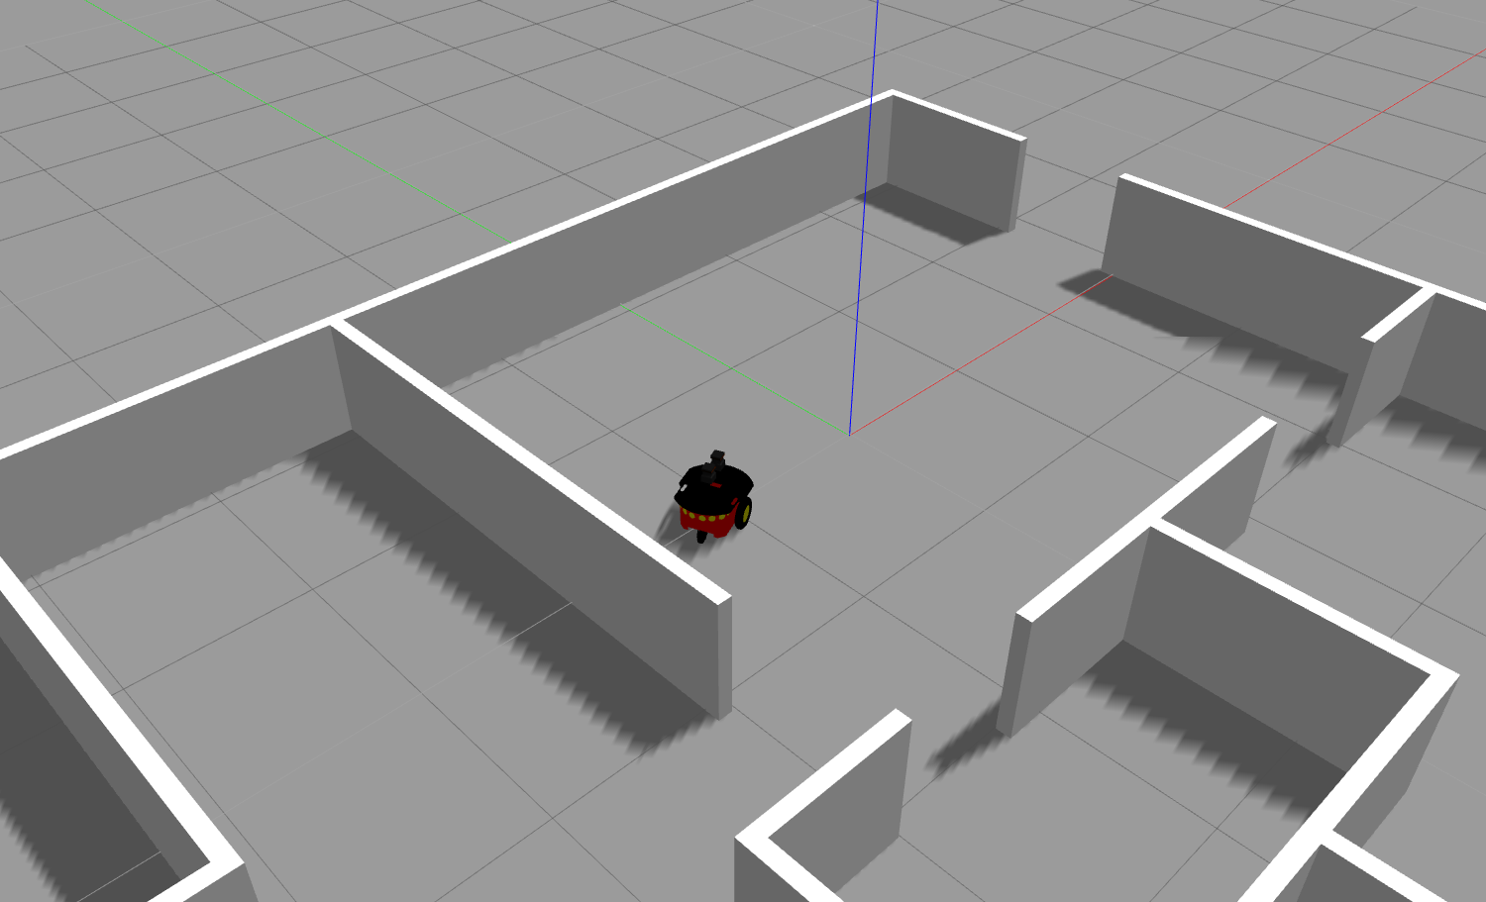
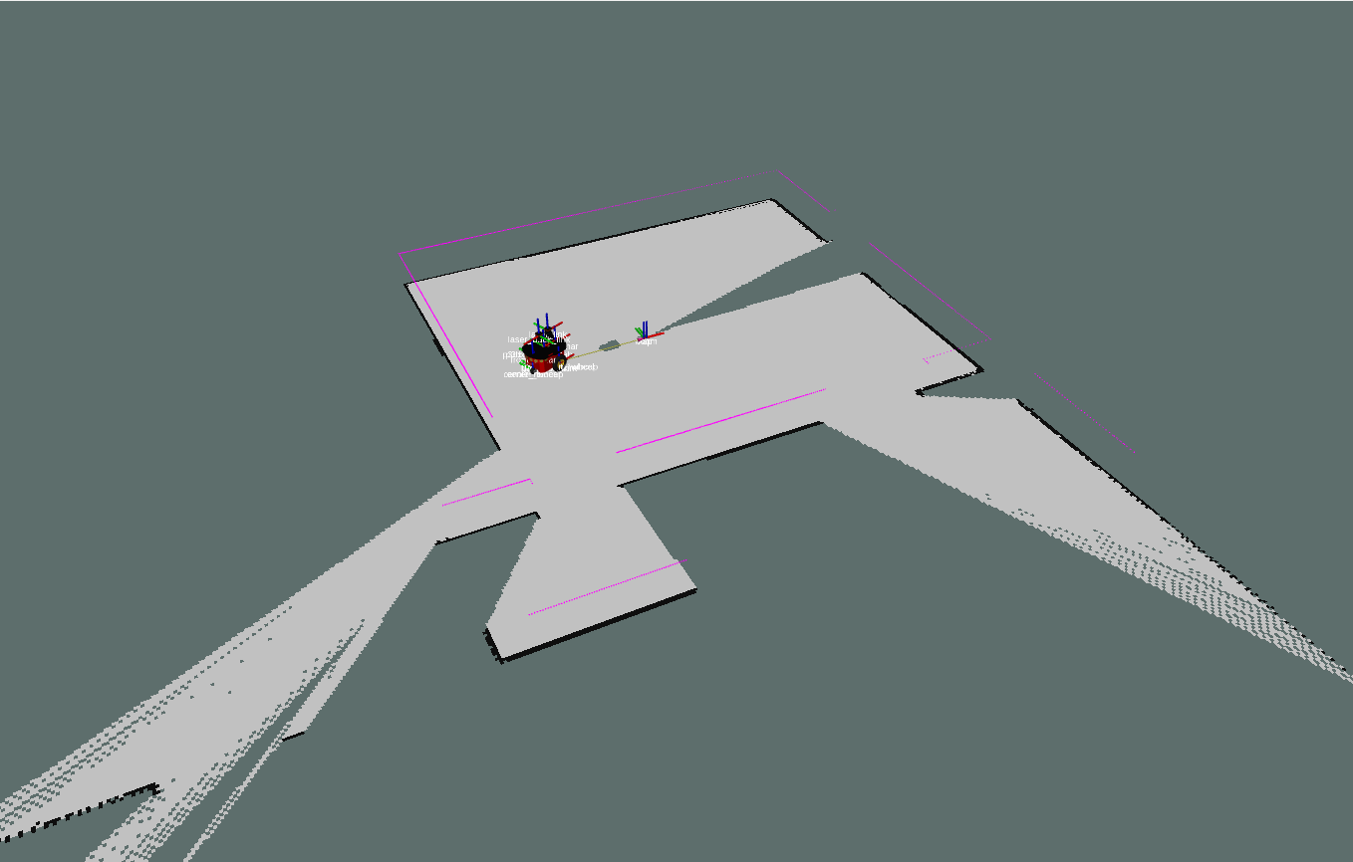
Construct 2D Map and Localize

Slide 4
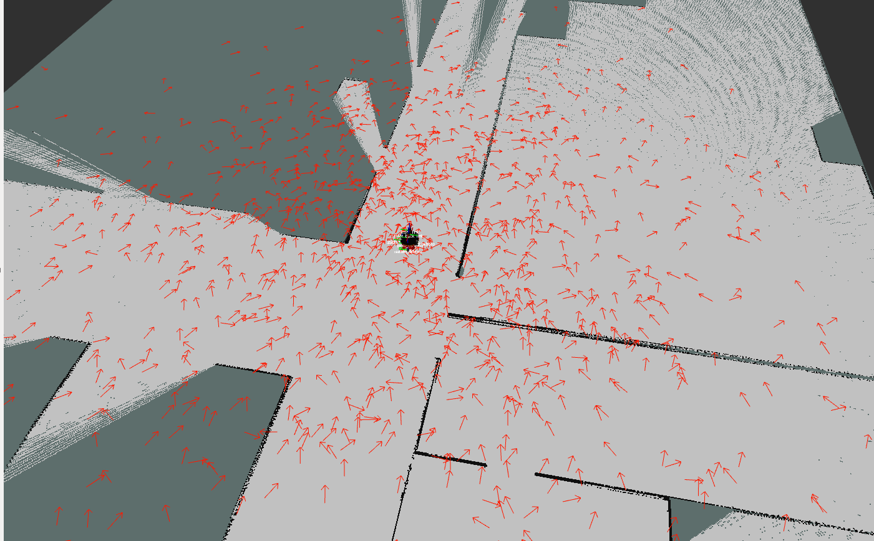
Localization

Slide 5
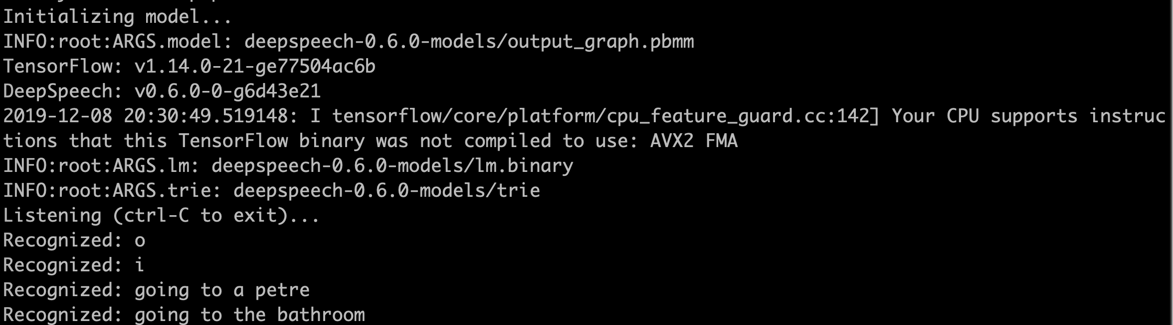
Speech Recognition Progress
Using DeepSpeech package
small LM model
small memory footprint
fine word error rate
microphone VAD streaming
Communicate with robot control node through ros
https://github.com/mozilla/DeepSpeech
Notes:
using speech recognition package DeepSpeech, which has small size model and memory footprint and its accuracy is fine
its constantly record the voice streaming using VAD (voice active detection)
and the python program will communicate with the robot through ros framework

Slide 6
Things to do
voice/speech part
recognize each person’s voice to determine who is newcomer
maybe chat with newcomers while guiding them
object detection part
recognize the place during localization
robot trajectory and planning
aggregate all the parts
refine some parts
Notes:
here are the things remain to do.
the voice part, we should solve some problem like recognizing the person’s voice to identify the newcomer or by using face recognition. Besides, we can maybe chat with the newcomer while guiding them.
We still have robot control part remain to do like planning.
And after all the parts are done, we’ll assemble them together and finally refine the project

Slide 7
Thanks for listening
Notes:
That’s all, thanks for listening

